Slide 1

VisayasMed
IT
SLIDE PRESENTATION FOR NEW EMPLOYEES

Slide 2
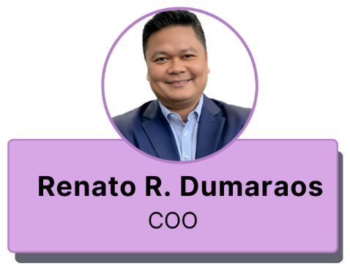
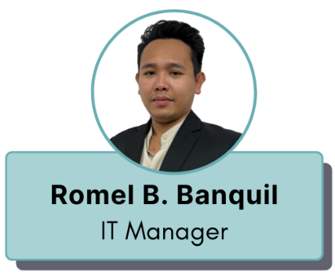
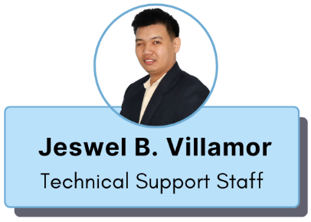
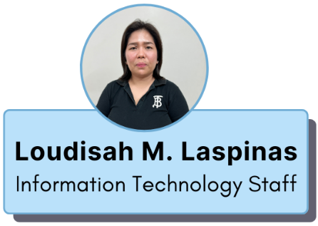
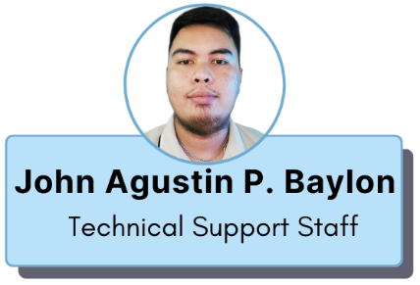

Slide 3

What we do?
Scope and Responsibilities
SERVER
SECURITY
CLOUD SERVICES
INTERNET BACKBONE
Install, configure
and maintain
VisayasMed servers
Taking care of every aspect of security to protect systems from cyber threats, malware and hacking attempts.
Manage different cloud services and subscriptions critical to VisayasMed operations.
Ensures that VisayasMed is operating 24 x 7.

Slide 4
What we do?
Scope and Responsibilities
TECHNICAL SUPPORT
ACCESS MANAGEMENT
DATA & STORAGE MANAGEMENT
TELECOMS
BACK UP & DISASTER RECOVERY
END USER MANAGEMENT
APPLICATION MANAGEMENT
VENDOR MANAGEMENT

Slide 5

VisayasMed
ACCEPTABLE USE STANDARD
SLIDE PRESENTATION FOR NEW EMPLOYEES

Slide 6
General Requirements
01
02
Avoid leaving your laptop anywhere. You may keep it in a locked drawer or cabinet before going home.
Always lock your workstation whenever you leave the device unattended.
03
04
Do not download or possess any unapproved, unauthorized, or unlicensed application or software.
Do not write down passwords and/or stick them on tables or monitors.

Slide 7
General Requirements
Avoid downloading copyrighted content, such as music, images, and videos/movies.
Do not leave printed or handwritten documents that contain sensitive information exposed; keep it locked in a closed drawer or cabinet
05
06
Do not use company internet for non-business purposes and accessing of prohibited sites
Avoid storing VisayasMed Information in portable medias (unless authorized and using approved encrypted media).
07
08
Maintain regular back-up and saving of critical company files in an VisayasMed authorized location (SharePoint, OneDrive)
09

Slide 8
Thank You
&
Welcome to
VisayasMed

